Slide 1
The F# Language
January 29th 2024
A functional-first programming language
for the .NET platform and the Web
Dr. Thomas C. Chust

Slide 2
Outline
History and Related Languages
Notable Features
  Cross-Platform Support
  Immutability
  Structured Types and Pattern Matching
  Units of Measure
  Adaptive and Reactive Programming
  Asynchronous Programming
Interesting Frameworks
  SciSharp
  ML.NET
  XPlot
  FSharp.Data
  FSharp.Data.Adaptive
  Aardvark
  WebSharper or Fable
  Xamarin

Slide 3
History and Related Languages
Created around 2005 in an effort to expand the set of available programming languages on the .NET platform
Syntactically a member of the ML family of languages in general and
similar to OCaml in particular
Also influenced by Erlang, Haskell, Python, Scala, C#
Fully cross-platform since around 2010
(initially through Mono, nowadays with .NET Core)
Current stable version 8.0, fully supported by Microsoft

Slide 4
Hello World!
Interactive Shell
F# can be used interactively
(Jupyter notebook integration exists)
F# can be used like a script interpreter
Most code is an expression with a value
The language is strongly typed
Types can be inferred in many cases
PS1> dotnet fsi
Microsoft (R) F# Interactive, Version 12.8.0.0 für F# 8.0
Copyright (C) Microsoft Corporation. Alle Rechte vorbehalten.
Um Hilfe zu erhalten, geben Sie "#help;;" ein.
> printfn "Hello world!";;
Hello world!
val it: unit = ()
> sprintf "Hello %s!" "world";;
val it: string = "Hello world!"
> #quit;;
Hello.fsx
let who = "world"
printfn "Hello %s! How are you?" who
Interactive Shell
PS1> dotnet fsi Hello.fsx
Hello world! How are you?

Slide 5
Hello World!
Hello.fs
F# integrates with the .NET library ecosystem, project model and tools
Several IDEs and editor plugins exist to support working with F# and MSBuild
It‘s easy to compile, run, and test from the command line using the .NET Core tools
Cross compilation is fully supported
[<EntryPoint>]
let main args =
let who =
match Array.tryHead args with
| Some v -> v
| None -> "world"
printfn "Hello %s! How are you?" who
0
Hello.fsproj
<Project Sdk="Microsoft.NET.Sdk">
<PropertyGroup>
<OutputType>exe</OutputType>
<TargetFramework>net8.0</TargetFramework>
</PropertyGroup>
<ItemGroup>
<Compile Include="Hello.fs" />
</ItemGroup>
</Project>
Interactive Shell
PS1> dotnet run
Hello world! How are you?
PS1> dotnet run -- foo
Hello foo! How are you?
PS1> dotnet publish -r linux-x64 --self-contained
MSBuild-Version 17.8.3+195e7f5a3 für .NET
Wiederherzustellende Projekte werden ermittelt...
"S:\Personal\FSharpTalk\Hello\Hello.fsproj" wiederhergestellt (in "6.09 sec").
Hello -> S:\Personal\FSharpTalk\Hello\bin\Release\net8.0\linux-x64\Hello.dll
Hello -> S:\Personal\FSharpTalk\Hello\bin\Release\net8.0\linux-x64\publish\

Slide 6
Structured Types and Pattern Matching
type Direction =
| XParallel
| YParallel
| Slanted of float
let directionAngle d =
match d with
| XParallel -> 0.0
| YParallel -> 90.0
| Slanted v -> v
type Measurement =
{
Layer : string
Position : float * float
Direction : Direction
}
let measurementAngle { Direction = d } =
directionAngle d
let myMeasurement =
{
Layer = "1(0)"
Position = (4.0, 2.0)
Direction = XParallel
}
let myMeasurement' =
{ myMeasurement with
Direction = Slanted 45.0
}
Union types can be used to represent simple enumerations, but cases can also have arguments
Unions and records automatically support comparison operations, hashing, and serialization
(unless explicitly suppressed)
Records and union cases can be destructured using pattern matching wherever a variable is bound
Match expressions can differentiate multiple union cases

Slide 7
Class Types and Primary Constructors
HellOO.fsx
F# also supports class types with object-oriented semantics
Syntactic sugar eases the declaration of a primary constructor
By default, instance variables are private
By default, methods, properties, and events are public
type Greeter(who:string) =
let greeting = $"Hello %s{who}! How are you?"
member _.SayHello() =
stdout.WriteLine(greeting)
Greeter("world").SayHello()
Interactive Shell
PS1> dotnet fsi HellOO.fsx
Hello world! How are you?

Slide 8
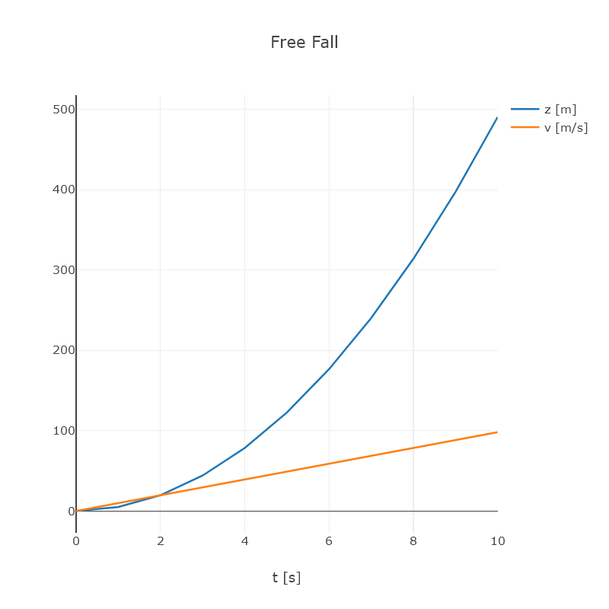
Units of Measure
#r "nuget: XPlot.Plotly, 4.0.6"
#load "AutoDiff.fs"
open FSharp.Data.UnitSystems.SI.UnitSymbols
open Murphy.AutoDiff
open XPlot.Plotly
let g = 9.81<m/s^2>
let fall (t:DFloat<s>) = g/2.0 * t*t
let points =
[ 0.0 .. 10.0 ]
|> List.map (fun t ->
let t = DFloat.Var (t * 1.0<s>)
t, fall t
)
let chart =
let xs = points |> List.map (fun (t, _) -> t.Value / 1.0<s>)
let zs = points |> List.map (fun (_, z) -> z.Value / 1.0<m>)
let vs = points |> List.map (fun (t, z) -> z.Derive(t).Value / 1.0<m/s>)
Chart.Plot [
Scatter(x = xs, y = zs, mode = "lines", name = "z [m]")
Scatter(x = xs, y = vs, mode = "lines", name = "v [m/s]")
]
|> Chart.WithLayout (Layout(
title = "Free Fall",
xaxis = Xaxis(title = "t [s]")
))
chart
|> Chart.WithWidth 640
|> Chart.WithHeight 640
|> Chart.Show

Slide 9
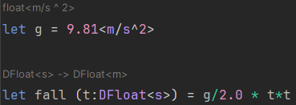
Units of Measure
#r "nuget: XPlot.Plotly, 4.0.6"
#load "AutoDiff.fs"
open FSharp.Data.UnitSystems.SI.UnitSymbols
open Murphy.AutoDiff
open XPlot.Plotly
let g = 9.81<m/s^2>
let fall (t:DFloat<s>) = g/2.0 * t*t
let points =
[ 0.0 .. 10.0 ]
|> List.map (fun t ->
let t = DFloat.Var (t * 1.0<s>)
t, fall t
)
let chart =
let xs = points |> List.map (fun (t, _) -> t.Value / 1.0<s>)
let zs = points |> List.map (fun (_, z) -> z.Value / 1.0<m>)
let vs = points |> List.map (fun (t, z) -> z.Derive(t).Value / 1.0<m/s>)
Chart.Plot [
Scatter(x = xs, y = zs, mode = "lines", name = "z [m]")
Scatter(x = xs, y = vs, mode = "lines", name = "v [m/s]")
]
|> Chart.WithLayout (Layout(
title = "Free Fall",
xaxis = Xaxis(title = "t [s]")
))
chart
|> Chart.WithWidth 640
|> Chart.WithHeight 640
|> Chart.Show
F# supports physical units of measure
(or any units you define, really)
Type inference / checking takes the units into account and understands the semantics of arithmetic operators
IDEs can display inferred type annotations to assist the reader of the code

Slide 10
Automatic Differentiation
AutoDiff.fs
namespace Murphy.AutoDiff
open System
/// Floating point expression with automatic differentiation support.
[<AbstractClass>]
type DFloat<[<Measure>] 'U> private (value:float<'U>) =
/// Change the unit of measure, for cases where compiler type inference breaks down :-(
static let measurecast (x:DFloat<'u>) : DFloat<'v> = x |> box |> unbox
/// The value of the expression.
member _.Value = value
/// The sign of the expression.
member _.Sign = sign value
/// Extract the derivative of the expression with respect to the given variable.
abstract Derive : DFloat<'v> -> DFloat<'U / 'v>
override _.ToString() = string value
/// Generic zero constant.
static member Zero : DFloat<'U> =
{ new DFloat<'U>(0.0<_>) with
override this.Derive(_) = DFloat.Zero }
/// Constant expression with zero derivatives.
static member Val(value:float<'U>) =
{ new DFloat<'U>(value) with
override _.Derive(_) = DFloat.Zero }
/// Generic unity constant.
static member One : DFloat<'U> =
DFloat.Val(1.0 |> box |> unbox)
/// Variable expression with unit derivative (if differentiated with respect to itself).
static member Var(value:float<'U>) =
{ new DFloat<'U>(value) with
override this.Derive(var) =
if Object.ReferenceEquals(var, this) then
DFloat.One
else
DFloat.Zero }
/// Addition implementing the sum rule for derivatives.
static member (+) (a:DFloat<'U>, b:float<'U>) : DFloat<'U> =
{ new DFloat<'U>(a.Value + b) with
override _.Derive(var) = a.Derive(var) }
/// Addition implementing the sum rule for derivatives.
static member (+) (a:float<'U>, b:DFloat<'U>) : DFloat<'U> =
{ new DFloat<'U>(a + b.Value) with
override _.Derive(var) = b.Derive(var) }
/// Addition implementing the sum rule for derivatives.
static member (+) (a:DFloat<'U>, b:DFloat<'U>) : DFloat<'U> =
{ new DFloat<'U>(a.Value + b.Value) with
override _.Derive(var) = a.Derive(var) + b.Derive(var) }
/// Additive inverse implementing the sum rule for derivatives.
static member (~-) (a:DFloat<'U>) : DFloat<'U> =
{ new DFloat<'U>(-a.Value) with
override _.Derive(var) = -a.Derive(var) }
/// Subtraction implementing the sum rule for derivatives.
static member (-) (a:DFloat<'U>, b:float<'U>) : DFloat<'U> =
{ new DFloat<'U>(a.Value - b) with
override _.Derive(var) = a.Derive(var) }
/// Subtraction implementing the sum rule for derivatives.
static member (-) (a:float<'U>, b:DFloat<'U>) : DFloat<'U> =
{ new DFloat<'U>(a - b.Value) with
override _.Derive(var) = -b.Derive(var) }
/// Subtraction implementing the sum rule for derivatives.
static member (-) (a:DFloat<'U>, b:DFloat<'U>) : DFloat<'U> =
{ new DFloat<'U>(a.Value - b.Value) with
override _.Derive(var) = a.Derive(var) - b.Derive(var) }
/// Multiplication implementing the product rule for derivatives.
static member ( * ) (a:DFloat<'U>, b:float<'v>) : DFloat<'U * 'v> =
{ new DFloat<'U * 'v>(a.Value * b) with
override _.Derive(var) = a.Derive(var) * b }
/// Multiplication implementing the product rule for derivatives.
static member ( * ) (a:float<'v>, b:DFloat<'U>) : DFloat<'v * 'U> =
{ new DFloat<'U * 'v>(a * b.Value) with
override _.Derive(var) = a * b.Derive(var) }
/// Multiplication implementing the product rule for derivatives.
static member ( * ) (a:DFloat<'U>, b:DFloat<'v>) : DFloat<'U * 'v> =
{ new DFloat<'U * 'v>(a.Value * b.Value) with
override _.Derive(var) = (a.Derive(var) * b) + (a * b.Derive(var |> measurecast) |> measurecast) }
/// Division implementing the quotient rule for derivatives.
static member (/) (a:DFloat<'U>, b:float<'v>) : DFloat<'U / 'v> =
{ new DFloat<'U / 'v>(a.Value / b) with
override _.Derive(var) = a.Derive(var) / b }
/// Division implementing the quotient rule for derivatives.
static member (/) (a:float<'v>, b:DFloat<'U>) : DFloat<'v / 'U> =
{ new DFloat<'v / 'U>(a / b.Value) with
override _.Derive(var) = -a * (b.Derive(var) |> measurecast) / (b * b |> measurecast) }
/// Division implementing the quotient rule for derivatives.
static member (/) (a:DFloat<'U>, b:DFloat<'v>) : DFloat<'U / 'v> =
{ new DFloat<'U / 'v>(a.Value / b.Value) with
override _.Derive(var) = (a.Derive(var) / b) - (a * (b.Derive(var) |> measurecast) / (b * b |> measurecast)) }
/// Absolute value implementing the chain rule for derivatives.
static member Abs(x:DFloat<'U>) : DFloat<'U> =
{ new DFloat<'U>(abs x.Value) with
override _.Derive(var) = x.Derive(var) * double(sign x) }
/// Exponentiation implementing the power and chain rules for derivatives.
static member Pow(x:DFloat<1>, p:float) : DFloat<1> =
{ new DFloat<1>(x.Value ** double p) with
override _.Derive(var) = x.Derive(var) * p * x ** (p - 1.0) }
/// Exponential function implementing the chain rule for derivatives.
static member Exp(x:DFloat<1>) : DFloat<1> =
{ new DFloat<1>(exp x.Value) with
override _.Derive(var) = x.Derive(var) * exp x }
/// Logarithm function implementing the chain rule for derivatives.
static member Log(x:DFloat<1>) : DFloat<1> =
{ new DFloat<1>(log x.Value) with
override _.Derive(var) = x.Derive(var) / x }
/// Sine function implementing the chain rule for derivatives.
static member Sin(x:DFloat<1>) : DFloat<1> =
{ new DFloat<1>(sin x.Value) with
override _.Derive(var) = x.Derive(var) * cos x }
/// Cosine function implementing the chain rule for derivatives.
static member Cos(x:DFloat<1>) : DFloat<1> =
{ new DFloat<1>(cos x.Value) with
override _.Derive(var) = -x.Derive(var) * sin x }
(Library code used by „Units of Measure“ example)

Slide 11
Type Providers
Provider.fsx
F# supports programmatic extensions to its type system
Standard libraries exist to extract type structures from example data, like JSON, XML, or HTML documents, or relational databases
At runtime, data with the same structure can be loaded and queried with collection functions
#r "nuget: FSharp.Data, 6.3.0"
[<Literal>]
let dataUrl = "https://en.wikipedia.org/wiki/Comparison_of_programming_languages"
type TypedData = FSharp.Data.HtmlProvider<dataUrl>
let data = TypedData.Load(dataUrl)
let fsharp =
data.Tables.``General comparisonedit``.Rows
|> Array.find (fun row -> row.Language = "F#")
printfn "Language: %s" fsharp.Language
printfn "Functional? %s" fsharp.Functional
printfn "Object-oriented? %s" fsharp.``Object-oriented``
Interactive Shell
PS1> dotnet fsi Provider.fsx
Language: F#
Functional? Yes
Object-oriented? Yes

Slide 12
Adaptive Programming
React.fsx
A standard library exists for programming with „adaptive“ values
This allows the construction of spreadsheet-style data dependency graphs
Change transactions minimize the amount of superfluous callback events
#r "nuget: FSharp.Data.Adaptive, 1.2.14"
open FSharp.Data.UnitSystems.SI.UnitSymbols
open FSharp.Data.Adaptive
let timeToFloor (height:float<m>) (gravity:float<m/s^2>) : float<s> =
sqrt (2.0 * height / gravity)
let height = cval 10.0<m>
let gravity = cval 9.81<m/s^2>
let dropTime = AVal.map2 timeToFloor height gravity
dropTime.AddCallback(printfn "dropTime = %.3f s")
transact (fun () ->
height.Value <- 2000.0<m>
gravity.Value <- 24.79<m/s^2>
)
Interactive Shell
PS1> dotnet fsi React.fsx
dropTime = 1.428 s
dropTime = 12.703 s

Slide 13
Reactive Programming
Timer.fsx
Events are first class values in F#
In addition to supporting callbacks, events can be manipulated similar to sequence data types
Event callback registrations support the RAII paradigm
open System
open System.Timers
let timer = new Timer(1000(*ms*), AutoReset = true, Enabled = true)
do
let event, oddt =
timer.Elapsed
|> Event.partition (fun e ->
e.SignalTime.Second % 2 = 0
)
use subscription = event.Subscribe(fun e ->
Console.WriteLine("EvenSignalTime = {0:u}", e.SignalTime)
)
use _ = oddt.Subscribe(fun e ->
Console.WriteLine("OddSignalTime = {0:u}", e.SignalTime)
)
Threading.Thread.Sleep(3000(*ms*))
timer.Dispose()
Interactive Shell
PS1> dotnet fsi Timer.fsx
EvenSignalTime = 2024-01-27 15:22:04Z
OddSignalTime = 2024-01-27 15:22:05Z
EvenSignalTime = 2024-01-27 15:22:06Z

Slide 14
Asynchronicity, Callbacks, CPS
Option 1: Linear code
Option 2: Callback code
The structure corresponds, one level of callback nesting is inserted at every point of communication
Client
Server
use server = new Server()
let x = server.Foo()
let y = server.Bar(x)
ignore y
call Foo()
use server = new Server()
server.Foo(fun x ->
server.Bar(x, fun y ->
ignore y
)
)
return x
Time
call Bar(x)
return y

Slide 15
Asynchronous Programming
Feeds.fsx
F# supports automatic CPS conversion for asynchronous workflows
Instead of creating a tangled mess of nested callbacks, you write code that looks sequential
#r "nuget: System.ServiceModel.Syndication, 8.0.0"
open System
open System.ServiceModel.Syndication
let web = new Net.Http.HttpClient()
let getFeedAsync (uri:string) =
async {
let! ct = Async.CancellationToken
try
use! rs = web.GetStreamAsync(uri, ct) |> Async.AwaitTask
use xr = Xml.XmlReader.Create(rs)
return Ok (SyndicationFeed.Load xr)
with
| err ->
return Error err
}
[|
"https://foundation.fsharp.org/announcements.rss"
"https://www.tagesschau.de/xml/rss2/"
|]
|> Array.map getFeedAsync
|> Async.Parallel
|> Async.RunSynchronously
|> Array.iter (function
| Ok feed ->
for it in feed.Items do
printfn "- %s" it.Title.Text
| Error err ->
printfn "Error: %O" err
)
web.Dispose()
use server = new Server()
let x = server.Foo()
let y = server.Bar(x)
ignore y
async {
use server = new Server()
let! x = server.Foo()
let! y = server.Bar(x)
ignore y
}
Interactive Shell
PS1> dotnet fsi Feeds.fsx
- 2022 Board of Trustees Election
- F# Software Foundation Statement in Support of Ukraine
…
- Bündnis Sahra Wagenknecht: "Wir sind keine Linke 2.0"
- Bahnstreik endet vorzeitig in der Nacht zu Montag
…

Slide 16
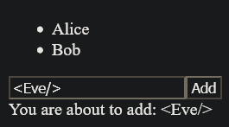
Web Programming
Client.fs
WebSharper compiles F# to JavaScript and HTML
A type provider can be used to interact with an existing HTML template
F# code on the client and server side can share types and communicate transparently
module [<WebSharper.JavaScript>] Client
open WebSharper.UI
open WebSharper.UI.Client
open WebSharper.UI.Html
let People =
ListModel.FromSeq [
"Alice"
"Bob"
]
let [<WebSharper.SPAEntryPoint>] main () =
let newName = Var.Create ""
div [] [
ul [] [
People.View.DocSeqCached(fun (name: string) ->
li [] [text name]
)
]
div [] [
input [ attr.placeholder "Name"; Attr.Value newName ] []
button [ on.click (fun _ _ -> People.Add(newName.Value)) ] [ text "Add" ]
div [] [ text "You are about to add: "; text newName.V ]
]
]
|> Doc.RunById "main"
Interactive Shell
PS1> dotnet new websharper-spa -lang 'F#' -o Web
Die Vorlage "WebSharper 6 Single-Page Application" wurde erfolgreich erstellt.
PS1> dotnet run --project Web
…
info: Microsoft.Hosting.Lifetime[14]
Now listening on: http://localhost:5000
…

Slide 17
Other Interesting Frameworks
SciSharp
Numerical primitives similar to numpy / scipy and
bindings to deep learning libraries
ML.NET
Model-based machine learning and inference
Aardvark
Advanced 3D visualization and GPU programming
WebSharper or Fable
Web applications using F# on the client and server side. WebSharper integrates best with .NET tooling while Fable integrates best with Node.js tooling
Xamarin
Mobile applications on Android and iOS

Slide 18
Summary
F# is a general purpose programming language with many useful libraries
(some specific to F#, some from the larger .NET ecosystem)
F# is a mature language with both an active OpenSource community and commercial backing
F# combines useful features of functional and object-oriented programming languages
The combination of strong typing, type inference, and interactive compilation makes the language well suited for rapid prototyping with fewer bugs
(Cross-)compilation and deployment of full applications is pretty easy
(thanks to .NET Core tooling)

